Slide 1
Navigating Behavioral Adventures
Kasee Stratton, Ph.D., NCSP
Dan Gadke, Ph.D., BCBA, NCSP

Slide 2
Contact Information
Kasee Stratton
Email: kstratton@colled.msstate.edu
Phone: 662-325-5461
Dan Gadke
Email: dgadke@colled.msstate.edu
Phone: 662-325-3312
Webpage: http://www.addc.msstate.edu/

Slide 3
Additional Contact Information
Bulldog CHARGE Research Lab
www.facebook.com/BulldogCHARGELab/
http://weringtrue.msstate.edu/charge/
Twitter: @BulldogCHARGE

Slide 4
Behavior 101

Slide 5
Goals
Empower you as parents and caregivers
View and think about behavior through a new lens

Slide 6
Keep in Mind…
All behavior serves a purpose
All behavior is learned
Behavior is a form of communication
Behavior involves interaction (and is maintained) by the environment
Our bodies are part of our environment…

Slide 7
Common Challenging Behaviors in CHARGE
Preference for certain items
Restricted range of interests
Difficulty with social relationships
Repetitive behaviors; increase under stress
Self injurious behavior
Aggressive
Pain Experiences

Slide 8
Why Behavior Happens?
Evidence-based Functions
Get ACCESS to:
Tangible Items
Social Attention
Intern Stimulation
ESCAPE:
Tangible items
Attention
Internal Stimulation

Slide 9
Functions of Behavior
Target Behavior
Obtain
Preferred
Environmental
Events
Escape/Avoid
Unpreferred
Environmental
Events
Preferred Activities
Or Items
Toys
Food
Money
Positive Tangible
Or Edible Reinforcement
Social
Attention
Smiles & laughter
Pats on back
Reprimands
Stares or looks
Positive Social
Reinforcement
Internal
Stimulation
Visual Stimulation
Auditory Stimulation
Kinesthetic Stimulation
Endorphin Release
Positive Automatic Reinforcement
NonPreferred
Activities
Or Items
Difficult assignment
Transitions
Change in Routine
Negative Activity
Reinforcement
Social
Attention
Smiles & laughter
Physical touch
Reprimands
Stares or looks
Negative Social
Reinforcement
Internal
Stimulation
Hunger
Pain
Itching
Negative
Automatic
Reinforcement

Slide 10
We Know…
It is all easier said than done.
Behavior is hard.
You are tough.

Slide 11
Behavior In The Schools

Slide 12
Warm-up
How many of you have IEPs?
How many of your children have “behavior problems/issues” in the school setting?
How many of you have a documented FBA and BIP as part of your child’s IEP?

Slide 13
The Problem
Children spend most of their days in school.
Many children with CHARGE have a host of behavior needs to address
Preliminary data:
36% had FBA or BIP; check box – 25% have goal
18% had behavior goal, no plan;
average 2.5 minutes per day

Slide 14
The Solution
Predictor of long term success – number of functional skills.
Schools should routinely address behavior needs and behavior skill development as part of child’s IEP.
Use Functional Behavior Assessment and Behavioral Intervention Plans

Slide 15
More Goals!
Discuss common pitfalls of behavior plans
Understand what a FBA is
Understand what a BIP is
Key behavior goals
CHARGE related examples

Slide 16
Pitfalls
Plans are often haphazard
Lack of evidenced-based interventions
Short lived
No data collection – “check box” method
Plan is not included in IEP

Slide 17
Most Behavior Plans

Slide 18
Functional Behavior Assessment

Slide 19
FBA
A systematic collection of data for the purposes of addressing:
WHY a behavior happens
In what SETTING behavior happens
INFORM intervention development

Slide 20
FBA Components
Indirect Measures
Direct Measures
Functional Analysis Procedures

Slide 21
Indirect Measures
Interviews
Teachers
PARENTS
Student?
Look at behavior history/records
ABC Logs

Slide 22
Direct Measures
Operationally defined behavior
Systematic Observations
More than 1
Across settings
Compared to peers
Permanent products
Rule-out/Consider Pain

Slide 23
Functional Analysis
Most specific and targeted of procedures
Rarely done
Lots of options
Tradition
Brief
Trial Based
Ask about it… minimize guessing; confirm data

Slide 24
Behavior Intervention Plan
Targeted intervention plan based on FBA data
Evidenced-based interventions are not “one size fits all”
Focus on Positive behavior supports/skill development
Need to teach replacement skills
NOT PUNATIVE

Slide 25
BIP Breakdown
Preventative Strategies
Skill Development/teaching
What behaviors are necessary to replace problem behavior
Response/consequences
How do we reinforce appropriate behavior
What do we do with problem behavior

Slide 26
Skills to Include
Almost all children with behavior concerns should have skills targeting…
Functional Communication Training
Compliance Training
Tolerance Training
Advocate

Slide 27
BIP Considerations
Who is going to implement?
Integrity checks?
Collect data?
What if behavior changes
New FBA!

Slide 28
“My BIP does not work!”
Most of the time… user error
Not a child problem
Intervention is not done with integrity
Intervention is given up on or withdrawn inappropriately
Assessment was not done appropriately

Slide 29
You mentioned IEP?
FBA and BIP should be included in IEP, not standalone
Protects child
Establishes clear goals (not just percentages)
Carry over across grades/teachers
One of strongest legal documents in country
BE SURE YOU HAVE A COPY BEFORE YOU LEAVE THE MEETING!

Slide 30
Red Flags
Your child has behavior concerns at school
Random intervention
“The behavior is random”
“We can’t see him/her until you work this out”

Slide 31
Behaviors to Consider
Self-stimulatory Behaviors
Self-injurious Behavior
Aggression
Non-compliance
Tantrums
Dropping
Any behavior impact daily life/success

Slide 32
Goals

Slide 33
Behavior Goals
What do you want to see?
How do you get there?
What resources do I need?
What changes in the environment are necessary?
What else do I need to know about the student?
Will what I teach now have an impact in 5 years? Positive? Negative impact?

Slide 34
Common Issues
Finding something that motivates the child
Missing the reinforcer
How immediate reinforcement is provided
Informing the child reinforcement is available and follow through

Slide 35
Wrapping Up
Know your rights for behavior
Ask for FBA
Behavior Plan
Look for red flags
Make sure the entire team understands behavior should be addressed first!
We need more than 2.5 minutes a day!
Behaviors plans don’t work because of adults, not kids

Slide 36
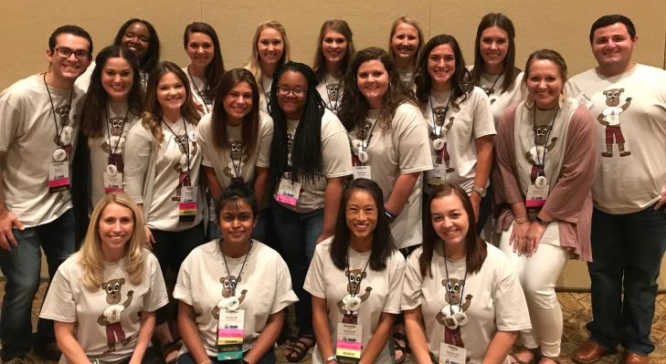
Bulldog CHARGE Research Lab

Slide 37
Projects
Family Demographics and Dynamics
If interested, please email: kks196@msstate.edu
IEPs and BIPs
Sexuality
Sleep
Analyzing Behavior & Interventions

